Slide 1
Building more accessible Powerpoints
Sustainability Moment
Your name
Your title
Your faculty/department name
Date of your sustainability moment

Slide 2
Accessible to whom?
People with visual disabilities
Screen readers convert text to speech or a Braille display
People with hearing disabilities
Subtitles/closed captions for videos
People with physical disabilities
Consider where the presentation will take place: location, setup
Notes:
Slide decks and other presentation tools (Qualtrics): used in the moment, but also after the fact as presentation supplement
Think about how what you’re building will be used – not just by the abled (i.e. consider how our presentations will interact with assistive devices)
Universal design: making our presentations more accessible to people with disabilities includes and benefits everyone

Slide 3
Building more accessible presentations
Use “Layout” function instead of manually inserting text/images
Format > Arrange > Selection Pane: check the reading order of the items on your slide
Avoid slide-only content
Include alternate text for visuals whenever possible
Try to link to videos that have closed captioning

Slide 4
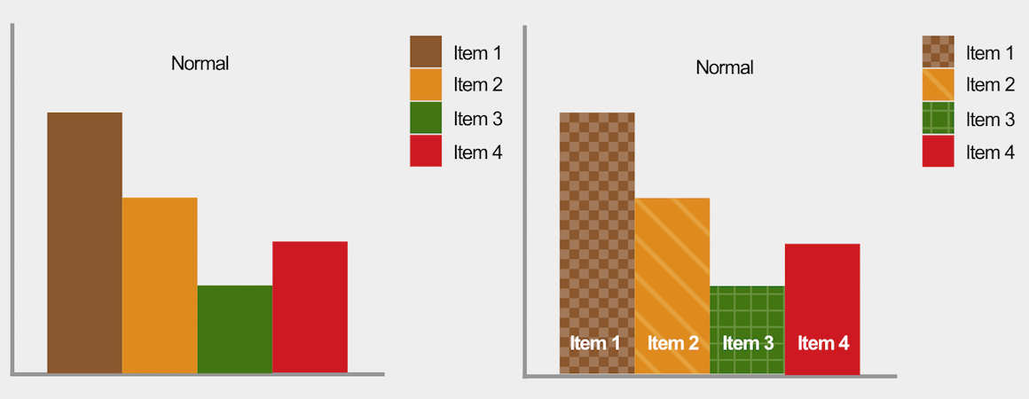
Formatting slides for accessibility
Use high-contrast text (i.e. black/white)
Readable font (i.e. Calibri)
Large font size: at least 18 pt, ideally 28pt+
Avoid using only colour to convey information
Notes:
- Note difference between coloured graphs and graphs with colour+pattern: a colourblind person could still register the difference between the columns in the graph on the right.

Slide 5
Further resources
Office 365 online support: Make your PowerPoint presentations accessible to people with disabilities
UMinnesota’s AccessibleU: Guide to building accessible Powerpoint slides

